Slide 1

Spring Integration
Dima Ionut Daniel

Slide 2
Contents
What is Spring Integration?
Enterprise Application Integration
Basics
Channels
Transformations
Routing and Filtering
Endpoints and Adapters
Monitoring
Conclusions
Bibliography

Slide 3

What is Spring Integration?
open source framework for Enterprise Application Integration.
easy development of event-driven architecture and messaging-centric architectures.
supports integration with external systems via declarative adapter.
part of Spring portofolio.

Slide 4
Enterprise Application Integration
EAI is used to integrate a set of enterprise computer applications.
EAI can be used for:
data integration
vendor independence
common facade

Slide 5
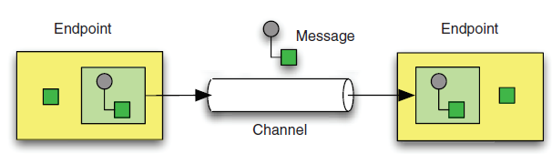
Enterprise Application Integration (cont.)
Enterprise Integration Patterns describes the patterns used in the exchange of messages, as well as the patterns that provide the glue between applications.
Only three base patterns make up enterprise integration patterns: Message, Message Channel, and Message Endpoint.

Slide 6
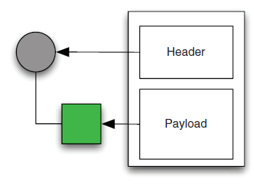
Basics
A message is a generic wrapper for any Java object combined with metadata.
Messages can contain information in any format for the sending and receiving endpoints.
Each message consists of headers and a payload.
The header contains data that’s relevant to the messaging system, such as the Return Address or Correlation ID.
The payload contains the actual data to be accessed or processed by the receiver.

Slide 7
Basics (cont.)
A message channel is the component through which messages are moved.
The channel effectively decouples the producer and consumer.
There are 2 types of messaging scenarios: point-to-point, and publish/subscribe.
MessageBuilder can be used to create Message objects.
@ServiceActivator indicates that a method is capable of handling a message or message payload.

Slide 8
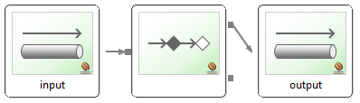
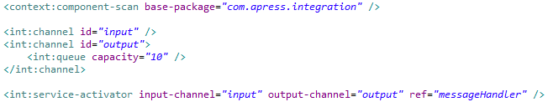
Basics (cont.)
A message endpoint is the abstraction layer between the application code and the messaging framework.
The main endpoint types supported by Spring Integration are:
Transformer: converts the message into another format.
Filter: Determines if the message should be passed to another channel.
Router: Sends to channel based on criteria
Splitter: generate multiple messages
Aggregator: combine messages
Service Activator: interface between message channel and service,
Channel adapter: connects channel to external system.

Slide 9
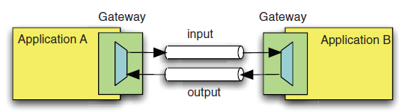
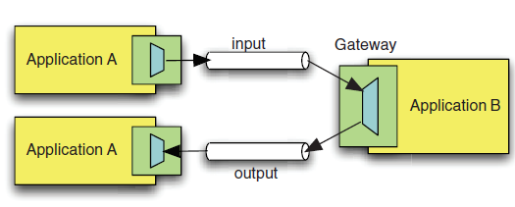
Basics (cont.)
A message gateway is a connection that's specific to bidirectional messaging.
Outbound gateways can be used for invoking web services and for synchronous request-reply interactions over JMS.

Slide 10
Basics (cont.)
A message endpoint is

Slide 11
Channels
A channel is a virtual data pipe that connects a sender to one or more receivers.
The message channel connects multiple endpoints together.
Spring Integration supports point-to-point channels and publisher-subscriber channels.
Point-to-Point Channels: QueueChannel, PriorityChannel, RendezvousChannel, DirectChannel, ExecutorChannel, and NullChannel.
Publish-Subscribe Channels: PublishSubscribeChannel.
All the Spring Integration channels implement the org.springframework.integration.MessageChannel.
To receive messages we can use:
org.springframework.integration.core.PollableChannel
org.springframework.integration.core.SubscribableChannel

Slide 12
Channels (cont.)
QueueChannel is the simplest implementation of a MessageChannel.
PriorityChannel is a subclass of QueueChannel and can receive messages in a specified priority based on a comparator.
RendezvousChannel is a synchronized version of QueueChannel; the sender will be blocked until the receiver receives the message from the channel.
DirectChannel is a mixture of the point-to-point and publish-subscribe channels.
It uses the publish-subscribe pattern so the message will be pushed to the receiver. but only one of the receivers can receive the same message at any given time.
NullChannel is used for unit testing.
ExecutorChannel is similar to DirectChannel but uses a TaskExecutor to dispatch the message.
ChannelInterceptor allows the message to be intercepted before it’s sent, after it’s sent, before it’s received, and after received.

Slide 13
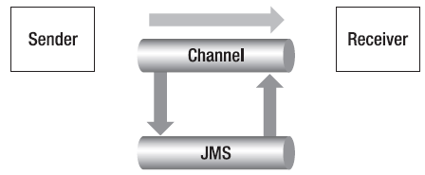
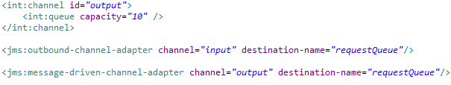
Channels (cont.)
Spring Integration message channels store messages in memory.
In Spring Integration 2.0 a message channel can be backed by JMS as an alternative to memory.
JMS-backed message channel decouples the message producer and consumer by making messaging asynchronously.

Slide 14
Transformations
A message consists of: payload and header.
A transformer can transform messages, accepts an input channel for incoming messages and an output channel for modifier messages.
We can specify the transfer using @Transformer or by using "method" attribute from <transformer> tag.
Spring Integration has built-in transformers in the core.
object-to-string-transformer → performs transformation using toString() method.
payload-serializing-transformer
payload-deserializing-transformer
object-to-map-transformer → need Jackson in classpath
map-to-object-transformer → need Jackson in classpath
json-to-object-transformer
object-to-json-transformer
payload-type-converting-transformer
Spring Integration can manipulate using 2 XML tranformers based on Spring OXM.

Slide 15
Transformations(cont.)
Spring Integration can enrich header information using <header-enrich> tag.
@Header and @Headers are use to retrieve header data in transformers.
@Payload is used to retrieve the payload from a message.
Spring Integration Messages and MessageHeaders are immutable.

Slide 16
Routing and Filtering
A message router decides what channel or channels should receive the message next. The decision is based on the message’s content and/or metadata contained in the message header.
A message filter determines if the message should be passed to the output channel.
A message splitter partitions an inbound message into several parts.
An aggregator combines multiple messages into a single message.
A resequencer works like a splitter and releases the messages to downstream components in a particular order.

Slide 17
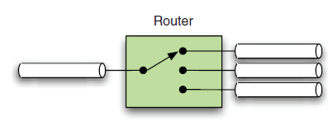
Routing and Filtering(cont.)
The org.springframework.integration.router package provides several implementations for Routers.
@Router is used as marker; expects the evaluation result of either a string for the channel name, a collection of names of MessageChannels, or a single MessageChannel.
A router may also be defined through a SpEL expression using expression attribute from <router> tag.
@ServiceActivator indicates that a method is capable of handling a message or message payload.
ReloadableResourceBundleExpressionSource reloads the expression from classpath resources.
Recipient-list-route tag can be use to configure a router using expression selectors.

Slide 18
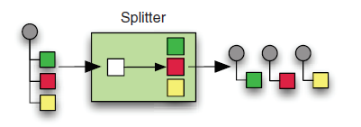
Routing and Filtering(cont.)
MessageSelector interface is used for filtering and exposes a single method called accept.
Returning true will forward the message to the output channel.
Spring Integration also supports a @Filter annotation to support message filters.
@Splitter annotation indicates that a method is capable of splitting a single message or message payload to produce multiple messages or payloads.

Slide 19
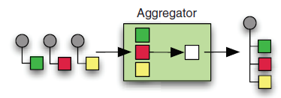
Routing and Filtering(cont.)
The aggregator combines any number of messages into one and sends it to the output channel.
A resequencer provides a way to insure that messages remain in sequence as determined by the value of the message header SEQUENCE_NUMBER.
MesssageHandlerChain is an implementation of MessageHandler that can be configured as a single endpoint while delegating a chain of other handlers; uses <chain> xml tag.
A message bridge is simply an endpoint that connects two message channels or two channel adapters together.

Slide 20
Endpoints and Adapters
An endpoint describes hos application code communicates with the messaging framework.
An endpoint hides the complexity of interacting with the messaging system.
There are 2 types of message consumers:
polling consumers
event-driven consumers

Slide 21
Endpoints and Adapters (cont.)
Using polling, the application can control when to receive the messages.
Here there is an issue of latency since the messages are polled at a specified rate.
Event-driven consumers will have no latency and a fixed set of concurrent consumers can be used to throttle the load.

Slide 22
Endpoints and Adapters (cont.)
A synchronous endpoint does not return until the downstream processing is finished.
A asynchronous endpoint returns immediately, allowing the downstream process to run in another execution thread.
Using service activator, a synchronous service endpoint can be exposed as an asynchronous service endpoint as well.
A service activator can be used to connect a message channel to the synchronous service endpoint.

Slide 23
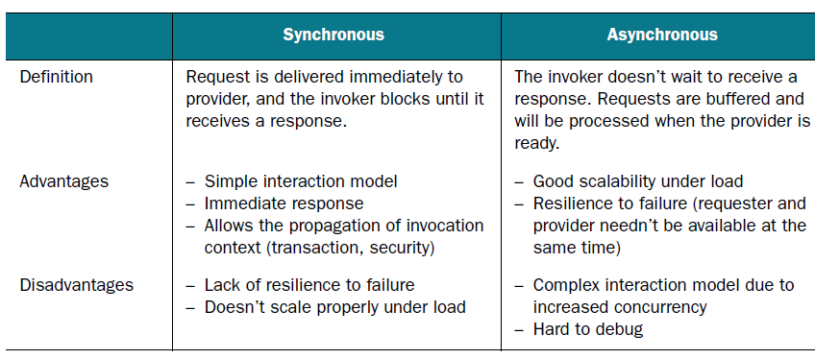
Endpoints and Adapters (cont.)

Slide 24
Endpoints and Adapters (cont.)
In order to receive a message, the application needs to understand how to retrieve a message from the message channel.
The application may need to poll the message channel for messages.
If the message channel is empty, the application may be blocked until a message arrives, or if the polling times out until the application can process some other business logic.
When the message arrives, the application can handle the message within the same thread or hand it off to a separate thread.

Slide 25
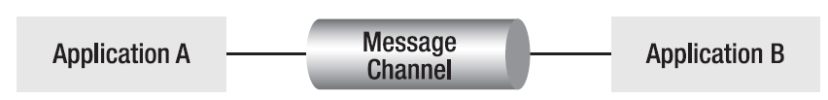
Endpoints and Adapters (cont.)
An endpoint that sends messages is called the message sender or producer, and the endpoint that receives messages is called the message receiver or consumer.
A message endpoint that receives messages from a message channel is called the inbound message endpoint.
A message endpoint that sends messages to a message channel is called the outbound message endpoint.
Both the inbound and outbound message endpoints can be polling or event-driven.

Slide 26
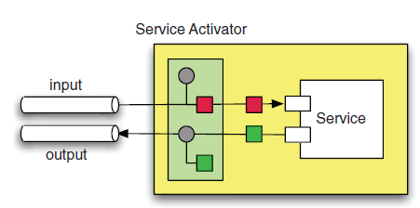
Endpoints and Adapters (cont.)
A service activator is a Spring Integration generic endpoint that handles incoming messages.
A service activator could be a method within a regular Java object and doesn't have to implement the message handler using the MessageHandler interface.
It invokes a service based on an incoming message and sends an outbound message based on the return value of this service invocation.

Slide 27
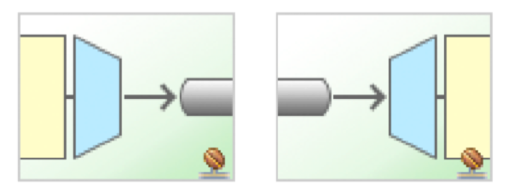
Endpoints and Adapters (cont.)
The adapter is the most important component for enterprise system integration.
An integration must be able to connect with disparate applications and services potentially using different communication protocols and underlying technologies.
Adapters provide the bridge between integration framework and the external systems and services.
Adapters can either be inbound or outbound.

Slide 28
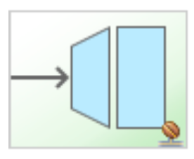
Endpoints and Adapters (cont.)
A messaging gateway is essentially a façade that allows the interface to a messaging system to be represented as a method or service call.
Integrating an application with a messaging framework requires composing messages and moving them through message channels using inbound and outbound channel adapters.
A gateway can be used to eliminate this coupling by creating a façade layer that abstracts away the functionality of the messaging system into a discrete interface.

Slide 29
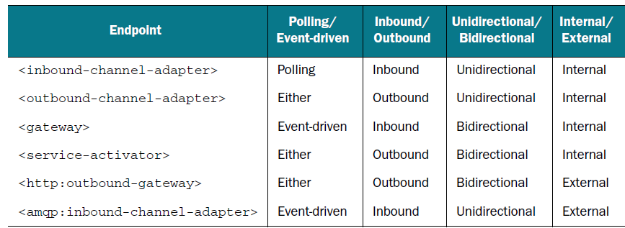
Endpoints and Adapters (cont.)
Different characteristics of Endpoints

Slide 30
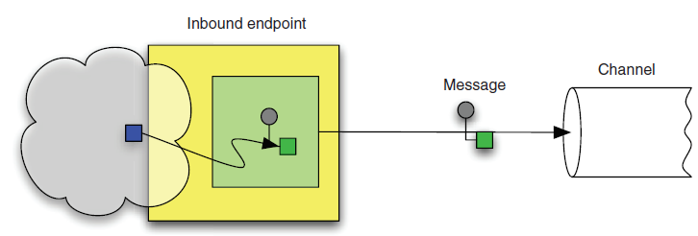
Endpoints and Adapters (cont.)
Input is taken from an external source and then converted into a message, which is sent to a channel.

Slide 31
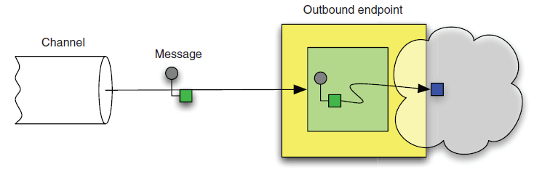
Endpoints and Adapters (cont.)
First a message is received from a channel and the message is converted into something the external component understands.
Finally the external API is invoked.

Slide 32
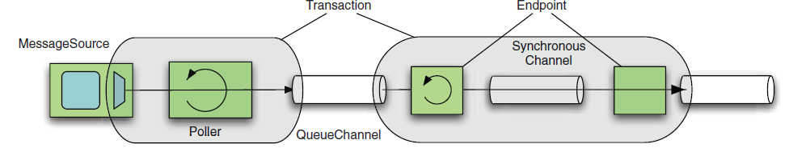
Endpoints and Adapters (cont.)
Transaction boundaries are determined by the scope of a given thread’s responsibility, so the transactional context doesn’t propagate across an asynchronous channel.

Slide 33
Endpoints and Adapters (cont.)
Spring Integration distribution includes support for following adapters:
Filesystem, FTP, or Secured File Transfer Protocol (SFTP)
User Datagram Protocol (UDP)
Transmission Control Protocol (TCP)
HTTP (Representational State Transfer [REST])
Web services (SOAP)
Mail (POP3 or IMAP for receiving, SMTP for sending)
Java Message Service (JMS)
Java Database Connectivity (JDBC)
Java Management Extensions (JMX)
Remote Method Invocation (RMI)
Really Simple Syndication (RSS) feeds
Twitter
Extensible Messaging and Presence Protocol (XMPP)

Slide 34
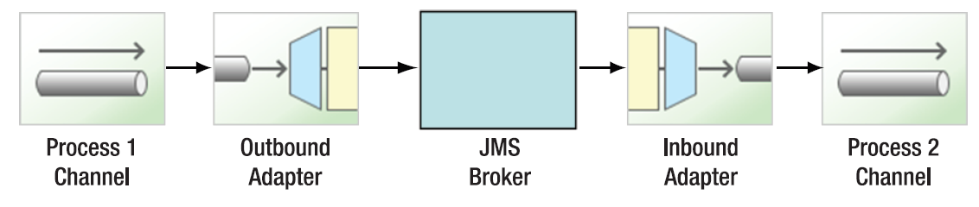
Monitoring
Errors are signaled through exceptions.
An exception aborts current execution, and forwards control to handler logic that can react to the exception.
Errors that occur between multiple systems are very difficult to diagnose.
Bellow is an example of process flow:

Slide 35
Monitoring (cont.)
Spring Integration supports the concept of an error channel.
If the thread sending the message to the channel is not the same as the thread of the one of the downstream handlers, any exception thrown by the handler will cause an error message to be sent to the error channel.

Slide 36
Monitoring (cont.)
The ability to manage the application is exposed through a management interface defined by a set of Management Beans (MBeans).
The MBeans are registered in an MBean server with a name or ObjectName.
The MBean may be accessed within the MBean server through a variety of protocols, including RMI, SNMP, and HTML.
Spring integration has support for both monitoring and managing other applications that leverage JMX.

Slide 37
Monitoring (cont.)
Spring Integration has several channel adapters for interacting with JMX.
This includes a channel adapter for sending and receiving JMX notifications as well as adapters for monitoring MBean attributes values and invoking MBean operations.
Adapters:
Notification Listening channel adapter
Notification Publishing channel adapter
Attribute Polling channel adapter
Operation Invoking channel adapter
Operation Invoking outbound gateway

Slide 38
Conclusions
Provide a simple model for implementing complex enterprise integration solutions.
Facilitate asynchronous, message-driven behavior within a Spring-based application.
Promote intuitive, incremental adoption for existing Spring users.

Slide 39

Bibliography
http://www.springsource.org/spring-integration
http://en.wikipedia.org/wiki/Enterprise_application_integration
Manning – Spring Integration in Action
Apress – Pro Spring Integration

